Slide 1


Karan Bhatt – Product Portfolio
Introduction:
Name: Karan Bhatt.
Organization: Tesla, Inc.
Role: Data Analyst.
Location: Austin, Texas (Howdy!).
LinkedIn: www.linkedin.com/in/karan-bhatt-k24.
Email: bhattkaran24@gmail.com.
Business Skills: Product Management.
Technical Skills: Data Analytics/Engineering.
Certification: PMC by The Product School.
From: India.

Slide 2
Product Index
YouTube – Scrolling.
YouTube – Skip Ad Android Auto.
YouTube – Follow.
Tesla – Troubleshooting Mode.
PS: The journey of discovering the problems is much more interesting than the solutions presented in the later slides. You are just one email/LinkedIn message away from an interesting discussion.

Slide 3
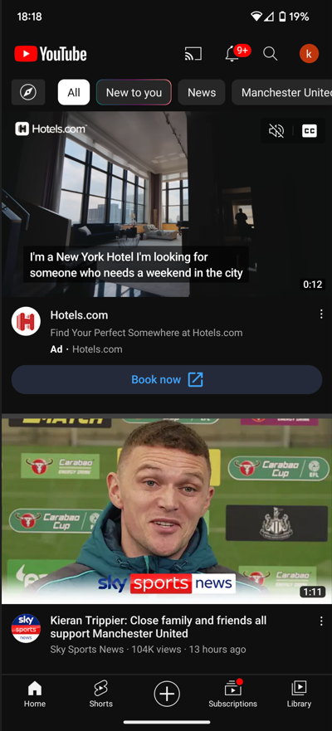
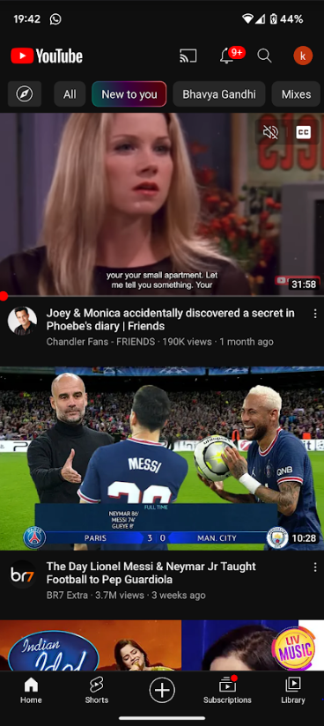
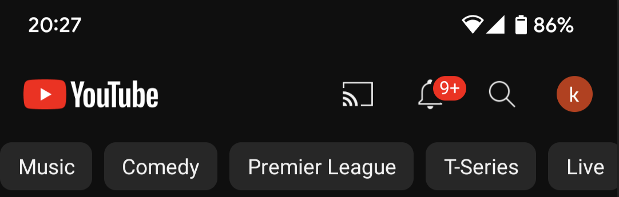
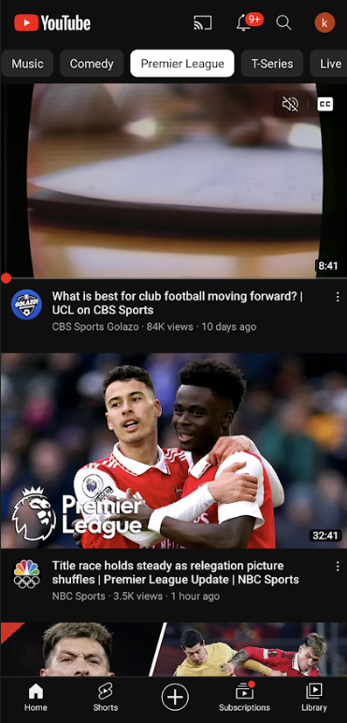
YouTube – Scrolling |
Pain Point: Mindless Scrolling.
Key Metric: Reduce idle time, Idle time: User is on YouTube but not watching video.
YouTube Current Version:
Home/All
New to you
Scroll right to see the different genre of contents that you like and then scroll down to arrive to a video of your liking.
Scroll up for more content
Scroll up for more content

Slide 4
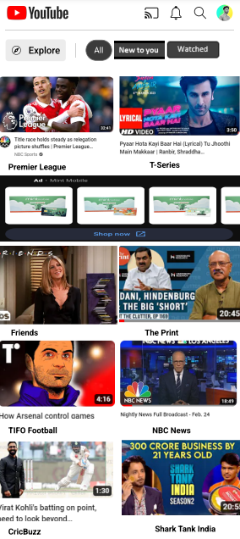
YouTube – Scrolling |
Pain Point: Mindless Scrolling.
Key Metric: Reduce idle time, Idle time: User is on YouTube but not watching video.
YouTube Suggested Version:
Pros:
All the new content from different genres presented at once.
User get to choose a genre & enjoy new content just by 2 touches.
This version allows user to explore 8 genres/videos at once as supposed to 2 videos in the current version.
This version allows possibility of displaying banner ad every time user enters this tab.
Reduction in idle time > More videos > More revenue.
Con:
Change in UI only for 1 tab inside the YouTube app might lead to a negative user experience.
Scroll up for more content

Slide 5
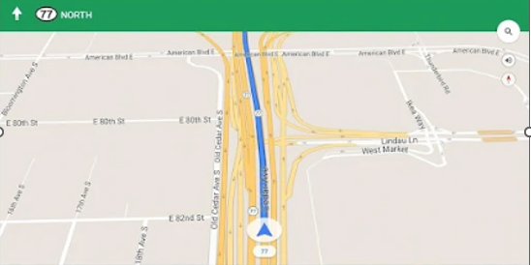
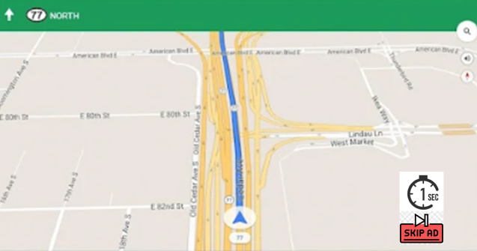
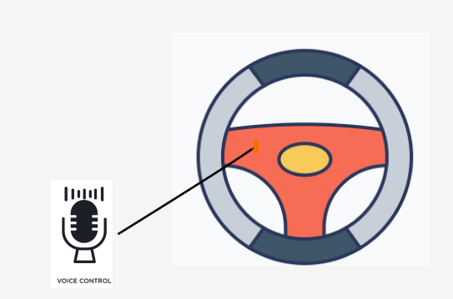
YouTube – Skip Ad Android Auto |
Pain Point: Distracted Driving.
Key Metric: Increase in feature usage count to ads ratio.
Current version: Suggested Version:
Solution: Skip ads over voice command or by double pressing the voice command button on your steering wheel.
Pros:
Enhanced Safety.
More adaption of YouTube and Android Auto.
Con:
Engineering.

Slide 6
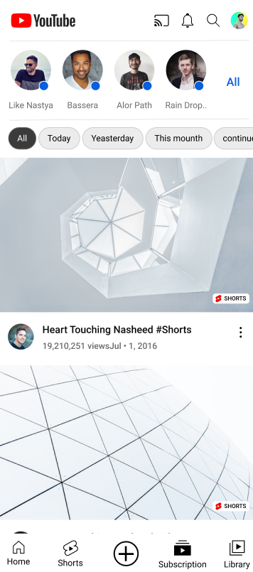
YouTube – Follow |
Pain Point: Poor community engagement.
Key Metric: Followers count per user.
YouTube Current Version:
Pain points:
Current subscription tab only lets the user view the video of the content creator whom they subscribed too.
New videos of the channels, a user subscribe too already gets feed on the Home tab.
It is a unidirectional channel i.e. viewers → content creator, whereas for building a community it needs to be bidirectional at minimum.
Subscription Tab

Slide 7
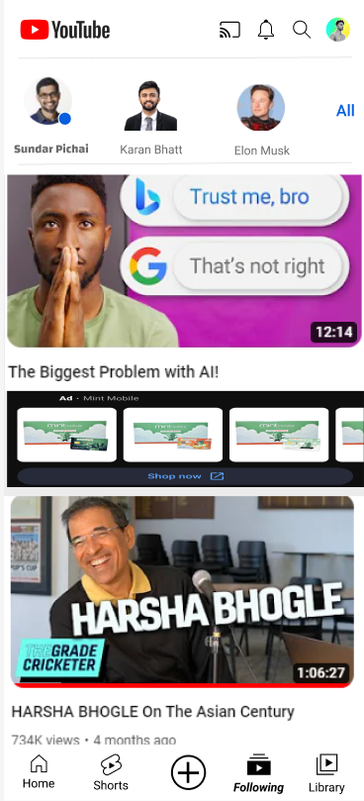
YouTube – Follow |
Pain Point: Poor community engagement.
Key Metric: Followers count per user.
YouTube Suggested Version:
Pros:
Just like Instagram or Twitter; Users can follow one another on YouTube.
User can mark any video for public sharing.
Users can get to know other users on more personal level, whether the user is a content creator or not. For e.g. by following Sundar Pichai (who is not a content creator yet!), a user can advent onto the videos that Sundar Pichai saw on YouTube.
Con:
Removing the subscription tab might discourage the content creator to make new content for YouTube.
Following Tab

Slide 8
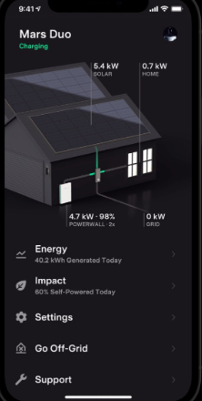

Tesla – Troubleshoot Mode |
Pain Point: Customer Safety.
Key Metric: # of customer support request.
Tesla Energy App Current Version:
Pain points:
A customer might try to self resolve an issue during a potentially hazardous situation.
A customer might try to self resolve an issue during wrong time.

Slide 9
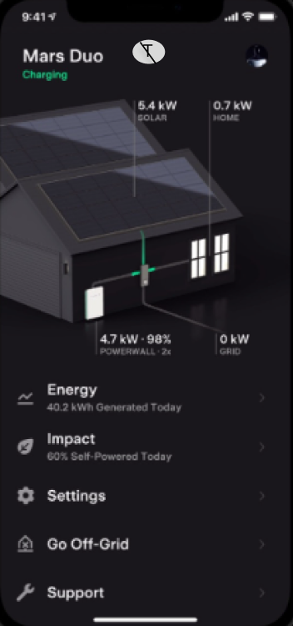
Tesla – Troubleshoot Mode |
Pain Point: Customer Safety.
Key Metric: # of customer support request.
Tesla Energy App Suggested Version:
Pros:
Safety (for customers and this feature can be extended to Tesla’s Field Technicians).
Enhances customer’s experience by saving customer’s time and effort.
Reduce the case volume for Customer Support so they can better focus on achieving Tesla’s mission.
Con:
Might deter/delay a customer’s willingness to self resolve an issue.
Do Not Troubleshoot Right Now
Tesla detects and determines if a site is safe and worth for troubleshooting by a customer or not. If it is not, then a Do Not Troubleshoot Right Now tab appears on the app to intimate the user.

Slide 10
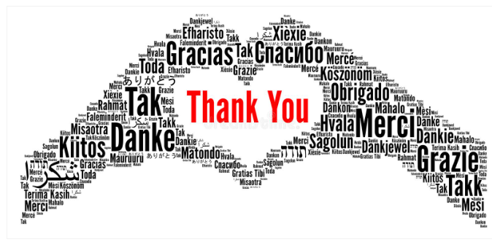
www.linkedin.com/in/karan-bhatt-k24 | bhattkaran24@gmail.com

